Slide 1


SY-Mini Project Tutorial -4
Bharathi H N Jyothi M Rao
Assistant Professor
Department of Computer Engineering
K. J. Somaiya College of Engineering
Somaiya Vidyavihar University

Slide 2
Acknowledgements
Slides material are taken from different sources including:
the slides of Mr. Shiyuan Jin’s UML class, EEL 4884, Fall 2003.
the slides of Yi Luo’s UML Lecture,EEL5881 Software Engineering I
Object-Oriented and Classical Software Engineering, Sixth Edition, WCB/McGraw-Hill, 2005 Stephen R. Schach
UML resource page http://www.uml.org/

Slide 3
Outline
Use of diagrams to design software system
Different types of diagrams
EER
USE case
Data flow

Slide 4
Diagrams used in Software Development
Use graphical notation: more clearly than natural language (imprecise) and code (too detailed).
Help acquire an overall view of a system.

Slide 5
UML
UML → “Unified Modeling Language”
It is a industry-standard graphical language for specifying, visualizing, constructing, and documenting the artifacts of software systems
Simplifies the complex process of software design

Slide 6
Types of UML diagrams
Entity relationship Diagram (Extensively studied in RDBMS course)
Use Case Diagram
Data flow diagram
Class Diagram
Sequence Diagram
Collaboration Diagram
State Diagram
Activity Diagram
This is only a subset of diagrams … but are most widely used

Slide 7
Example COMPANY Database
Create a database schema design based on the following (simplified) requirements of the COMPANY Database:
The company is organized into DEPARTMENTs. Each department has a name, number and an employee who manages the department. We keep track of the start date of the department manager. A department may have several locations.
Each department controls a number of PROJECTs. Each project has a unique name, unique number and is located at a single location.

Slide 8
Example COMPANY Database (Contd.)
We store each EMPLOYEE’s social security number, address, salary, sex, and birthdate.
Each employee works for one department but may work on several projects.
We keep track of the number of hours per week that an employee currently works on each project.
We also keep track of the direct supervisor of each employee.
Each employee may have a number of DEPENDENTs.
For each dependent, we keep track of their name, sex, birthdate, and relationship to the employee.

Slide 9
ER Model Concepts
Entities and Attributes
Entities(noun) are specific objects or things in the mini-world that are represented in the database.
For example the EMPLOYEE John Smith, the Research DEPARTMENT, the ProductX PROJECT
Attributes are properties used to describe an entity.
For example an EMPLOYEE entity may have the attributes Name, SSN, Address, Sex, BirthDate
A specific entity will have a value for each of its attributes.
For example a specific employee entity may have Name='John Smith', SSN='123456789', Address ='731, Fondren, Houston, TX', Sex='M', BirthDate='09-JAN-55‘
Each attribute has a value set (or data type) associated with it – e.g. integer, string, subrange, enumerated type, …

Slide 10
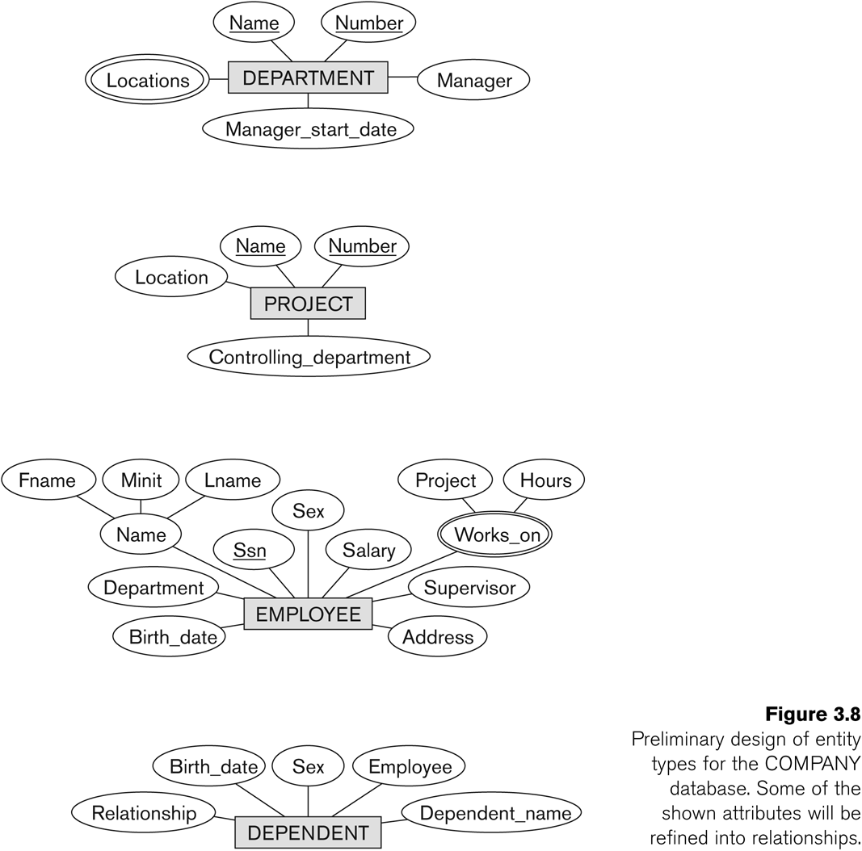
Initial Design of Entity Types: EMPLOYEE, DEPARTMENT, PROJECT, DEPENDENT

Slide 11
Refining the initial design by introducing relationships
The initial design is typically not complete
Some aspects in the requirements will be represented as relationships
ER model has three main concepts:
Entities (and their entity types and entity sets)
Attributes (simple, composite, multivalued)
Relationships (and their relationship types and relationship sets)
We introduce relationship concepts next

Slide 12
Relationships and Relationship Types (1)
A relationship relates two or more distinct entities with a specific meaning.
For example, EMPLOYEE John Smith works on the ProductX PROJECT, or EMPLOYEE Franklin Wong manages the Research DEPARTMENT.
Relationships of the same type are grouped or typed into a relationship type.
For example, the WORKS_ON relationship type in which EMPLOYEEs and PROJECTs participate, or the MANAGES relationship type in which EMPLOYEEs and DEPARTMENTs participate.
The degree of a relationship type is the number of participating entity types.
Both MANAGES and WORKS_ON are binary relationships.

Slide 13
Refining the COMPANY database schema by introducing relationships
By examining the requirements, six relationship types are identified
All are binary relationships( degree 2)
Listed below with their participating entity types:
WORKS_FOR (between EMPLOYEE, DEPARTMENT)
MANAGES (also between EMPLOYEE, DEPARTMENT)
CONTROLS (between DEPARTMENT, PROJECT)
WORKS_ON (between EMPLOYEE, PROJECT)
SUPERVISION (between EMPLOYEE (as subordinate), EMPLOYEE (as supervisor))
DEPENDENTS_OF (between EMPLOYEE, DEPENDENT)

Slide 14
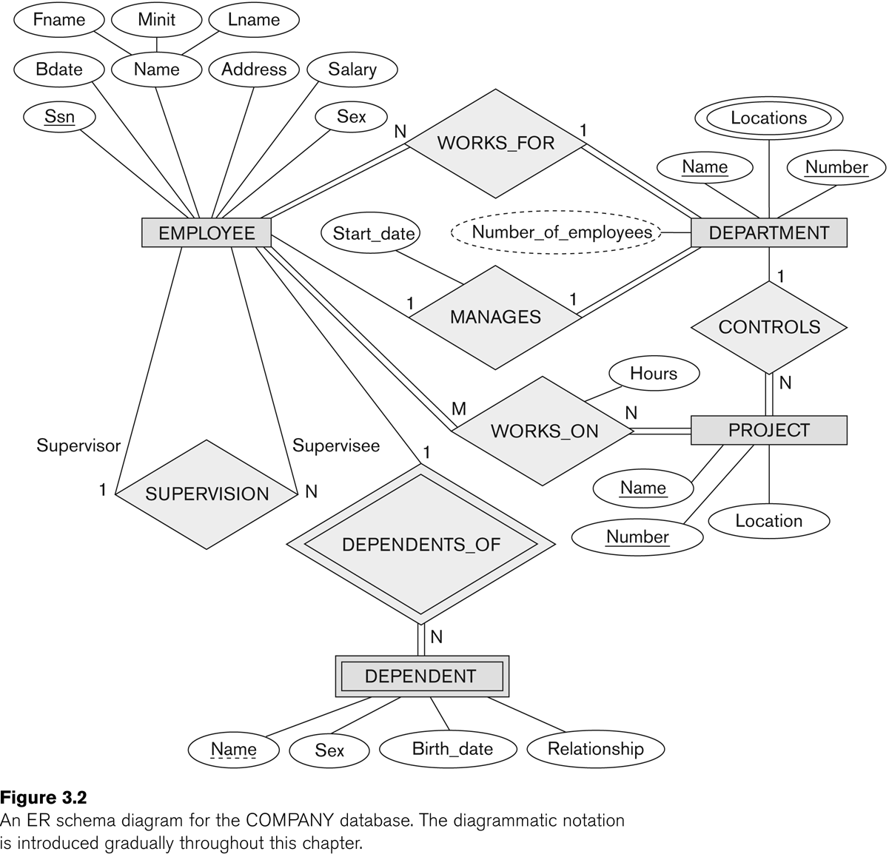
ER DIAGRAM – Relationship Types are: WORKS_FOR, MANAGES, WORKS_ON, CONTROLS, SUPERVISION, DEPENDENTS_OF

Slide 15
Use-Case Diagrams
A use-case diagram is a set of use cases
A use case is a model of the interaction between describing a set of user scenarios and capturing user requirements
External users of a software product (actors) and
The software product itself
More precisely, an actor is a user playing a specific role
contract between end user and software developers

Slide 16
Use-Case Diagrams
Library System
Use Case
Boundary
Actor
Borrow
Employee
Client
Order Title
Fine Remittance
Supervisor

Slide 17
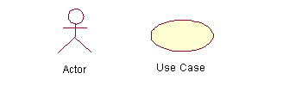
Use-Case Diagrams
Actors: A role that a user plays with respect to the system, including human users and other systems. e.g., inanimate physical objects (e.g. robot); an external system that needs some information from the current system.
Use case: A set of scenarios that describing an interaction between a user and a system, including alternatives.
System boundary: rectangle diagram representing the boundary between the actors and the system.

Slide 18
Use-Case Diagrams
Association:
communication between an actor and a use case; Represented by a solid line.
Generalization: relationship between one general use case and a special use case (used for defining special alternatives) Represented by a line with a triangular arrow head toward the parent use case.

Slide 19
Use-Case Diagrams
Include: a dotted line labeled <<include>> beginning at base use case and ending with an arrows pointing to the include use case. The include relationship occurs when a chunk of behavior is similar across more than one use case. Use “include” in stead of copying the description of that behavior.
<<include>>
Extend: a dotted line labeled <<extend>> with an arrow toward the base case. The extending use case may add behavior to the base use case. The base class declares “extension points”.
<<extend>>

Slide 20
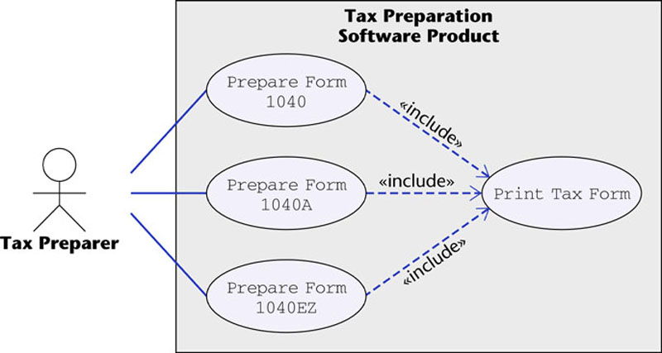
Use-Case Diagrams
Figure 16.12
The McGraw-Hill Companies, 2005

Slide 21
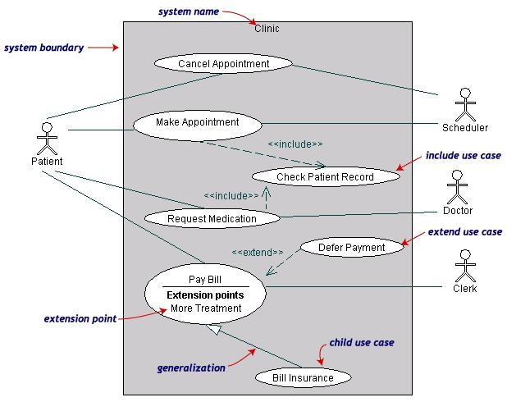
Use-Case Diagrams
Both Make Appointment and Request Medication include Check Patient Record as a subtask (include)
The extension point is written inside the base case Pay bill; the extending class Defer payment adds the behavior of this extension point. (extend)
Pay Bill is a parent use case and Bill Insurance is the child use case. (generalization)
(TogetherSoft, Inc)

Slide 22
Data Flow Diagrams

Slide 23
Key Definitions
Data flow diagramming shows business processes and the data that flows between them

Slide 24
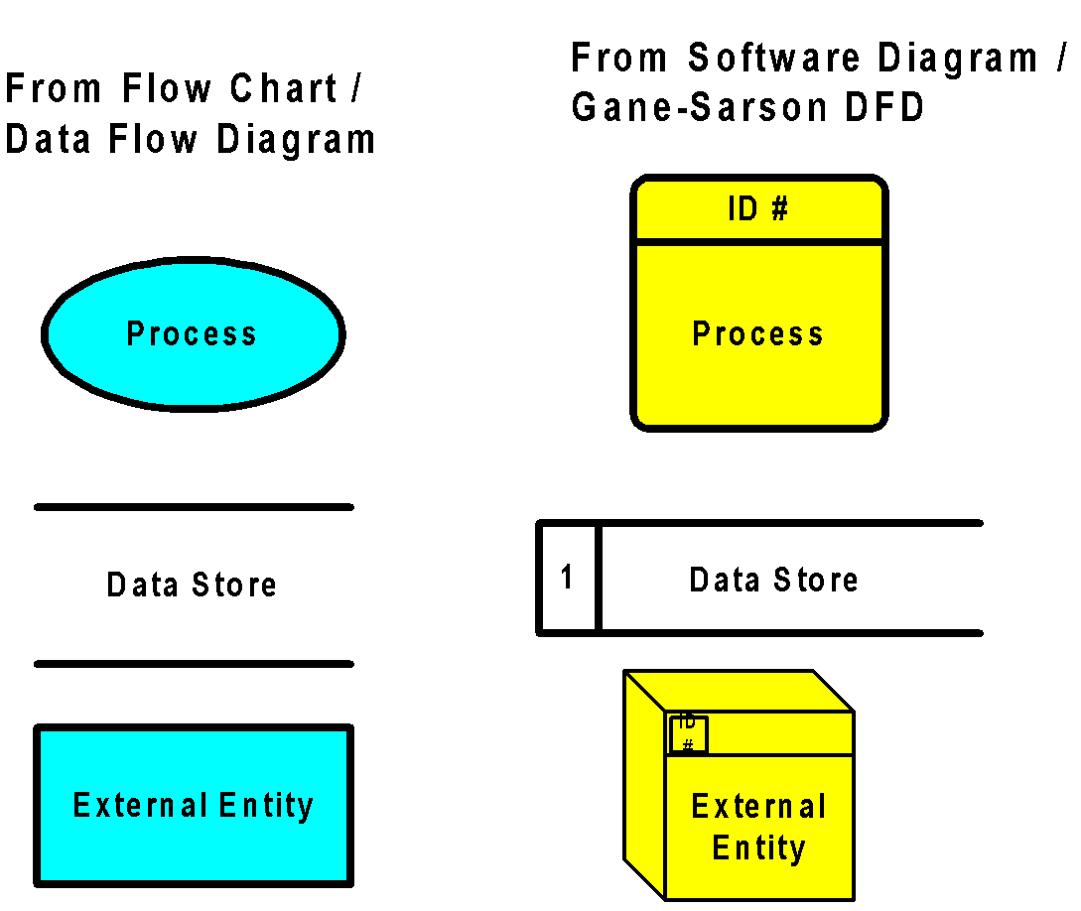
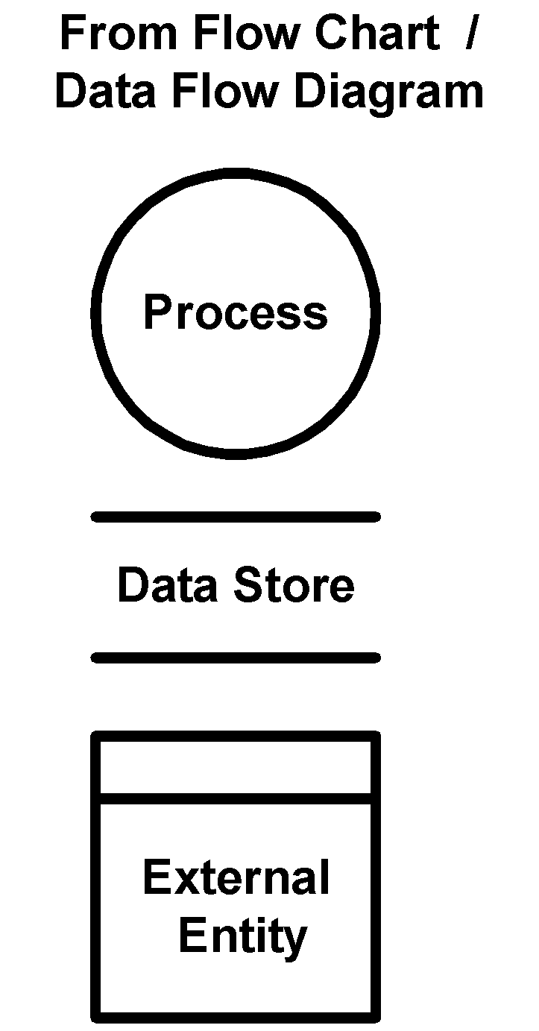
DFD Shapes from Visio
1- Data store , 2- process, 3- External entity
Visio 5.x
Visio 2000

Slide 25
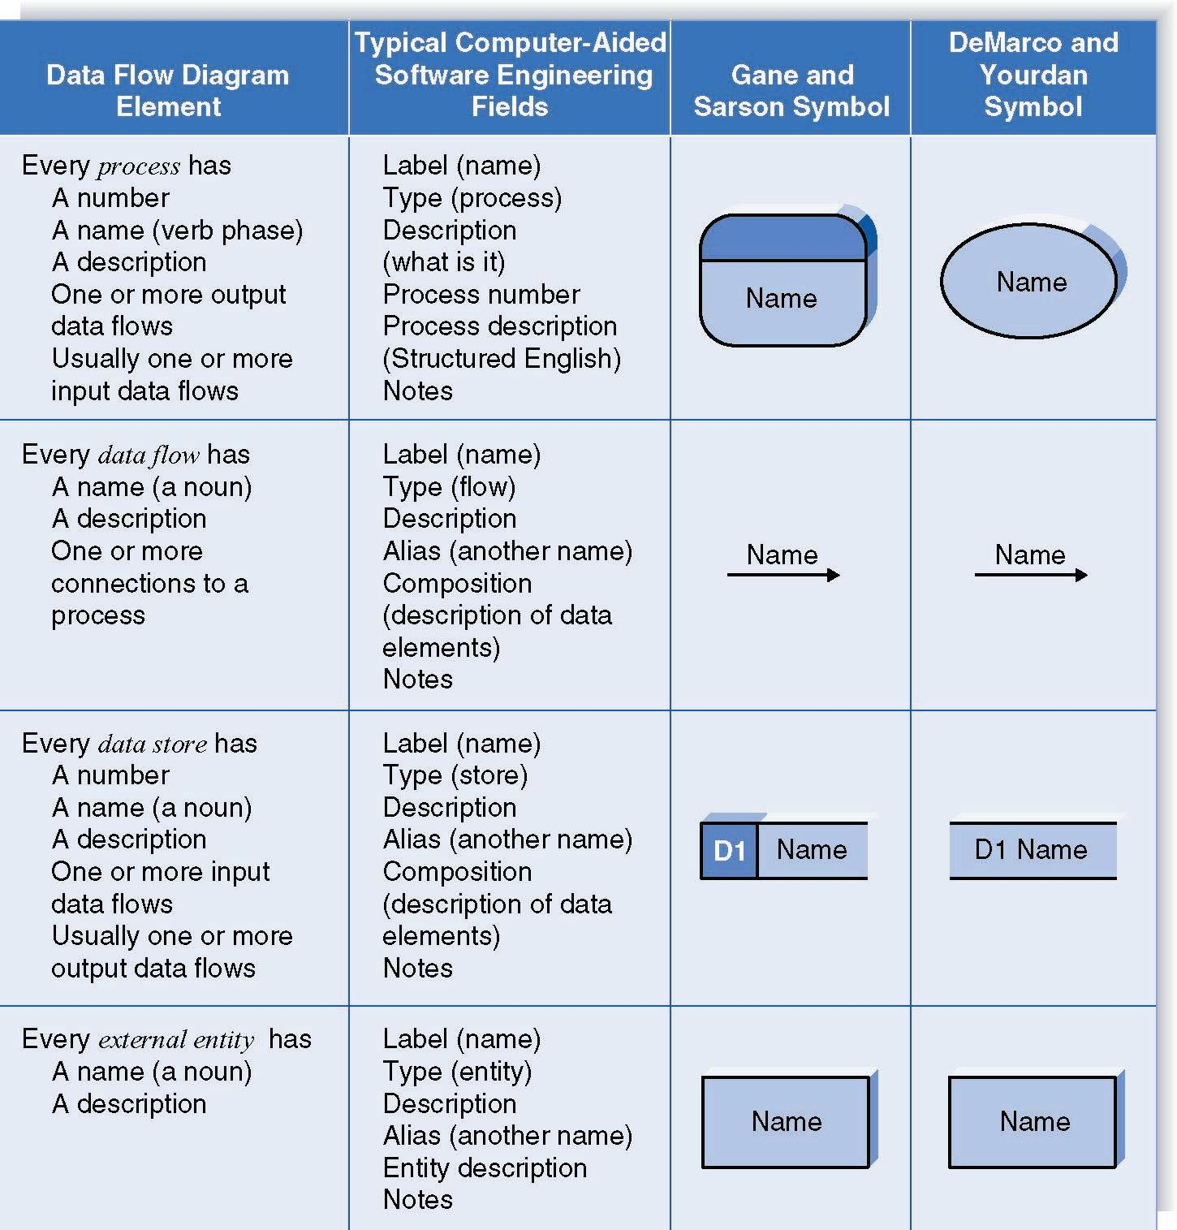
DFD Elements

Slide 26
Creating Data Flow Diagrams

Slide 27
Integrating Scenario Descriptions
DFDs generally integrate scenario descriptions
Names of use cases become processes
Names of inputs and outputs become data flows
Combining “small” data inputs and outputs into a single flow

Slide 28
Steps in Building DFDs
Build the context diagram
Create DFD fragments for each scenario
Organize DFD fragments into level 0
Decompose level 0 DFDs as needed
Validate DFDs with user

Slide 29
DFD Fragment Tips
All process names must be verb phrases
Maintain organization’s viewpoint in naming processes
Layouts often place
processes in the center
inputs from the left
outputs to the right
stores beneath the processes

Slide 30
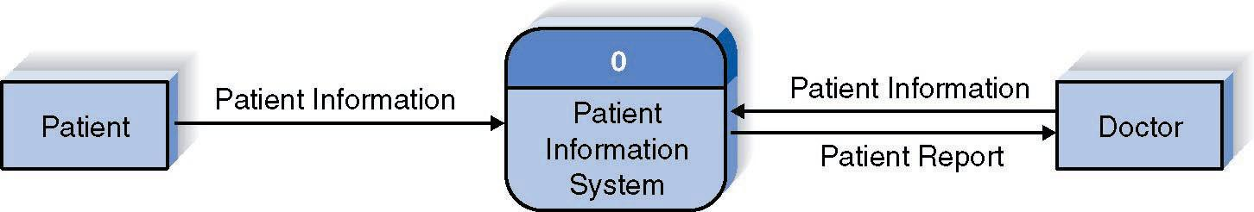
A DFD Fragment Example

Slide 31
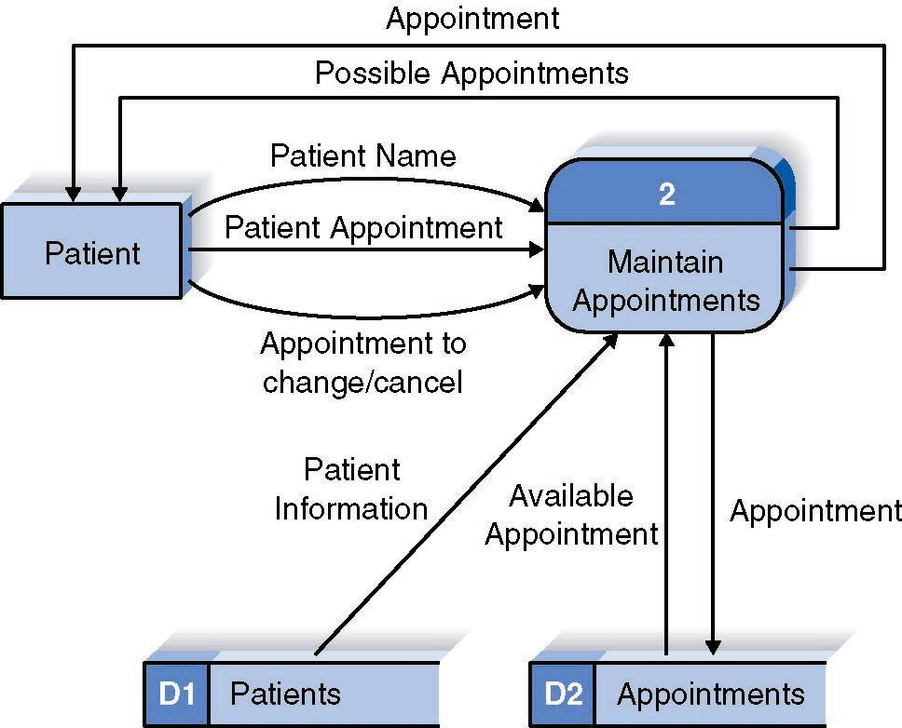
A Second DFD Fragment Example

Slide 32
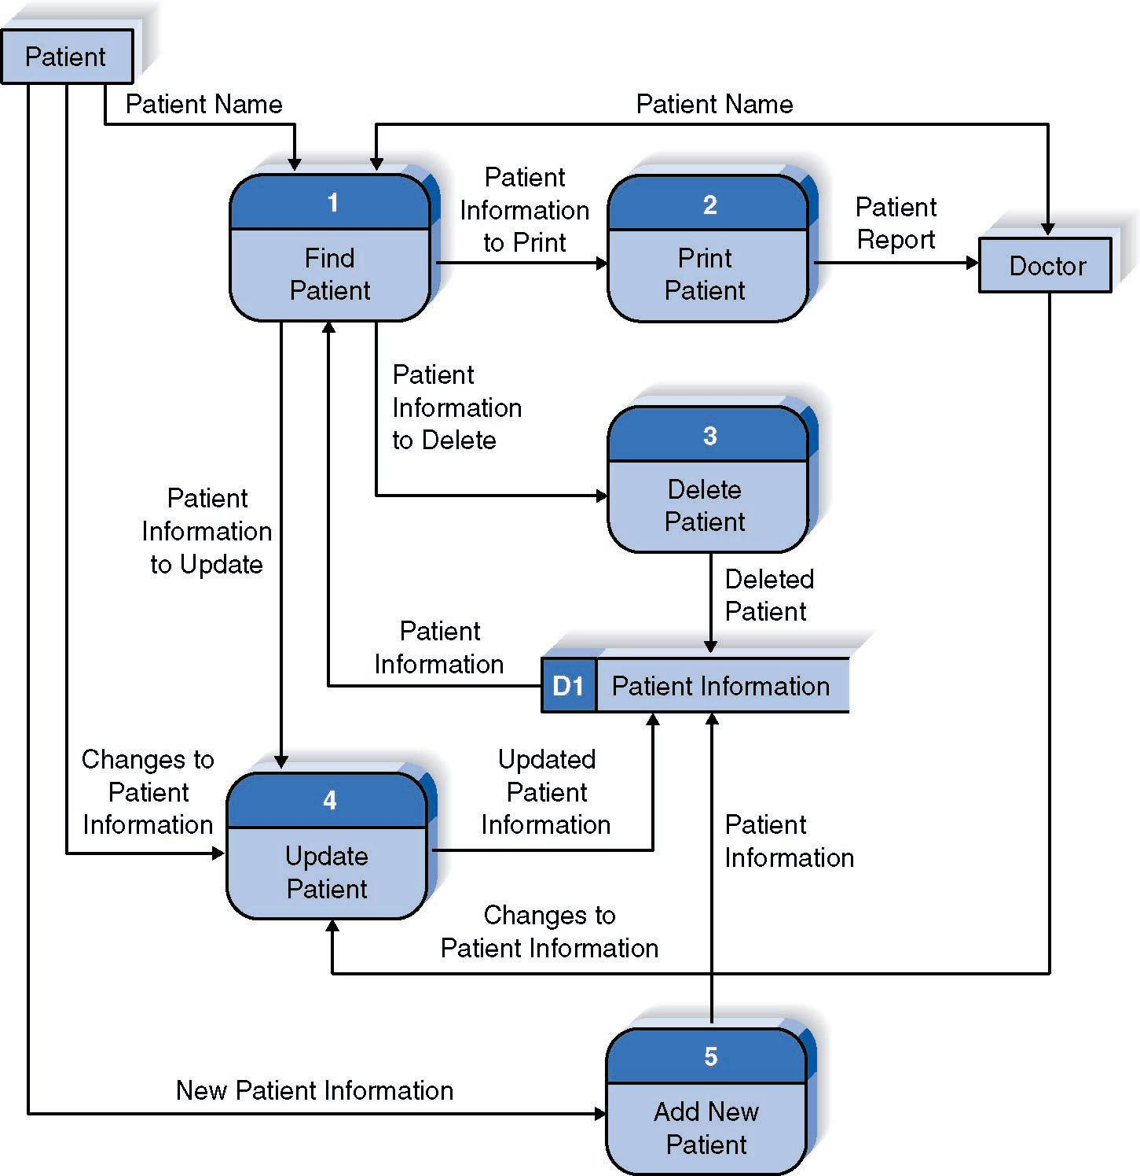
Reading a DFD

Slide 33
Key Definition
Decomposition is the process of modeling the system and its components in increasing levels of detail.
Balancing involves insuring that information presented at one level of a DFD is accurately represented in the next level DFD.

Slide 34
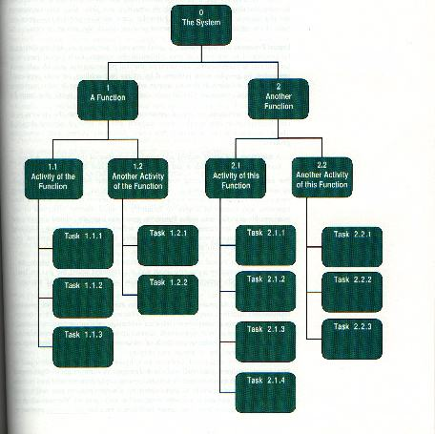
Decomposition Diagram

Slide 35
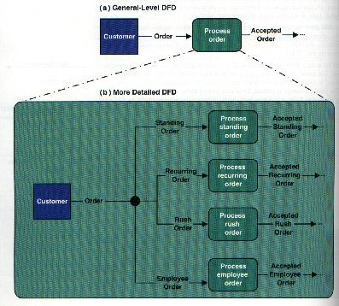
Composite & Elementary Flows

Slide 36
Level 0 Diagram
Shows all the processes that comprise the overall system
Shows how information moves from and to each process
Adds data stores

Slide 37
Level 0 Tips
Generally move from top to bottom, left to right
Minimize crossed lines
Iterate as needed
The DFD is often drawn many times before it is finished, even with very experienced systems analysts

Slide 38
Level 1 Diagrams
Shows all the processes that comprise a single process on the level 0 diagram
Shows how information moves from and to each of these processes
Shows in more detail the content of higher level process
Level 1 diagrams may not be needed for all level 0 processes

Slide 39
Tips for Level 1 and Below
Sources for inputs and outputs listed at higher level
List source and destination of data flows to processes and stores within each DFD
Depth of DFD depends on overall system complexity
Two processes generally don’t need lower level
More than seven processes become overly complex and difficult to read

Slide 40
Level 2 Diagrams
Shows all processes that comprise a single process on the level 1 diagram
Shows how information moves from and to each of these processes
Level 2 diagrams may not be needed for all level 1 processes
Correctly numbering each process helps the user understand where the process fits into the overall system

Slide 41
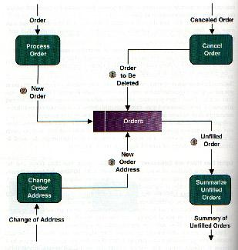
Flows to & from Data Stores

Slide 42
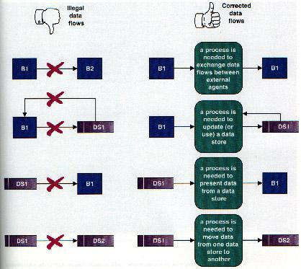
Illegal Data Flows

Slide 43
Data Flow Splits and Joins
A data flow split shows where a flow is broken into its component parts for use in separate processes
Data flow splits need not be mutually exclusive nor use all the data from the parent flow
A data flow join shows where components are merged to describe a more comprehensive flow

Slide 44
Validating the DFD
Syntax errors
Assure correct DFD structure
Semantics errors
Assure accuracy of DFD relative to actual/desired business processes
User walkthroughs
Role-play processes
Examine lowest level DFDs
Examine names carefully

Slide 45
UML Modeling tools
List of UML tools http://en.wikipedia.org/wiki/List_of_UML_tools
ArgoUML: http://argouml.tigris.org/
Rational Rose (www.rational.com) by IBM
UML Studio 7.1 ( http://www.pragsoft.com/) by Pragsoft Corporation: Capable of handling very large models (tens of thousands of classes). Educational License US$ 125.00; Freeware version.
TogetherSoft Control Center; TogetherSoft Solo (http://www.borland.com/together/index.html) by Borland

Slide 46
Thank you

